Slide 1
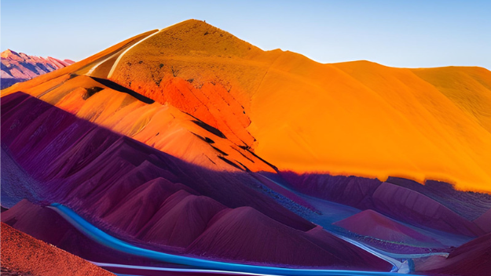
DYNAMIC HISTOGRAM EQUALIZATION AND COLOR HISTOGRAM EQUALIZATION
BY
HRITAM BASAK (114783055)
SAI RACHANA YERRAM (115401413)

Slide 2
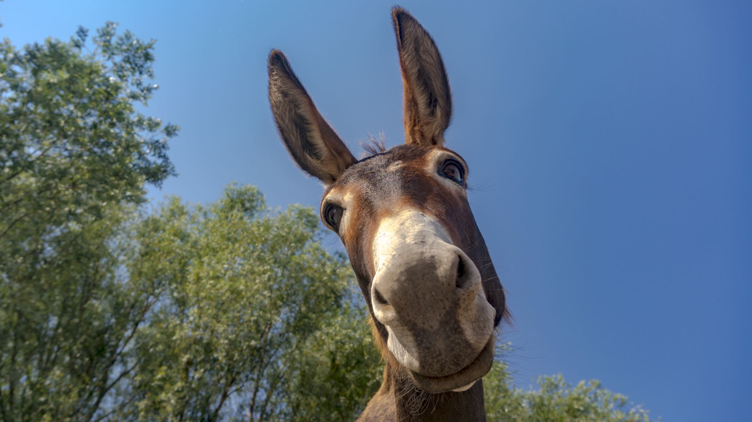
The Basics

Slide 3
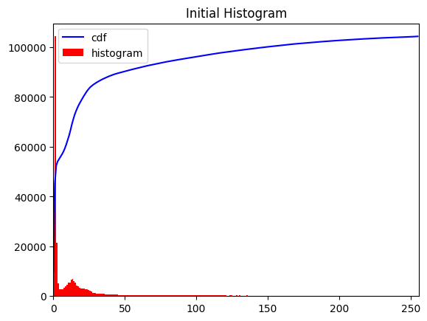
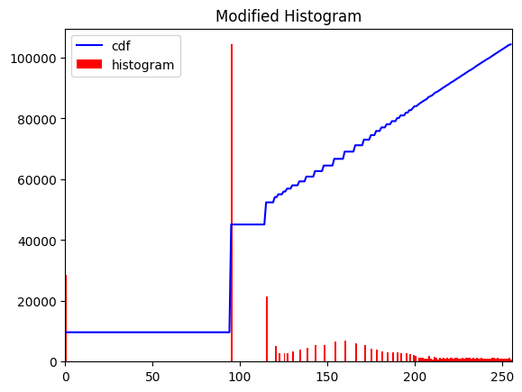
Flowchart
Step 1 Compute the image histogram | Step 2 Calculate the cumulative distribution function (CDF) | Step 3 Multiply the CDF by the maximum pixel value in the image. | Step 4 Round the resulting values to the nearest integer

Slide 4

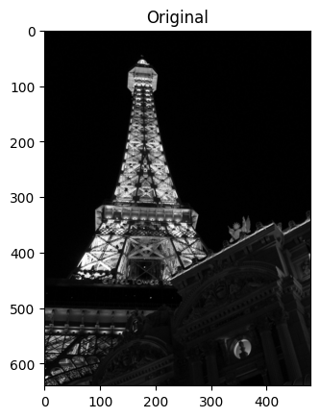
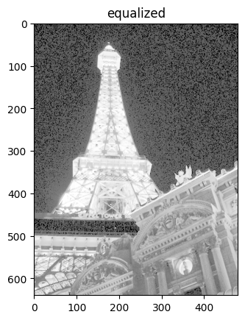

Slide 5
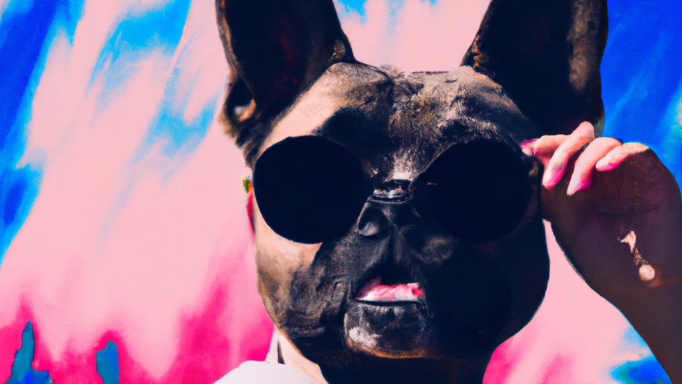
Differential Equation to the rescue

Slide 6
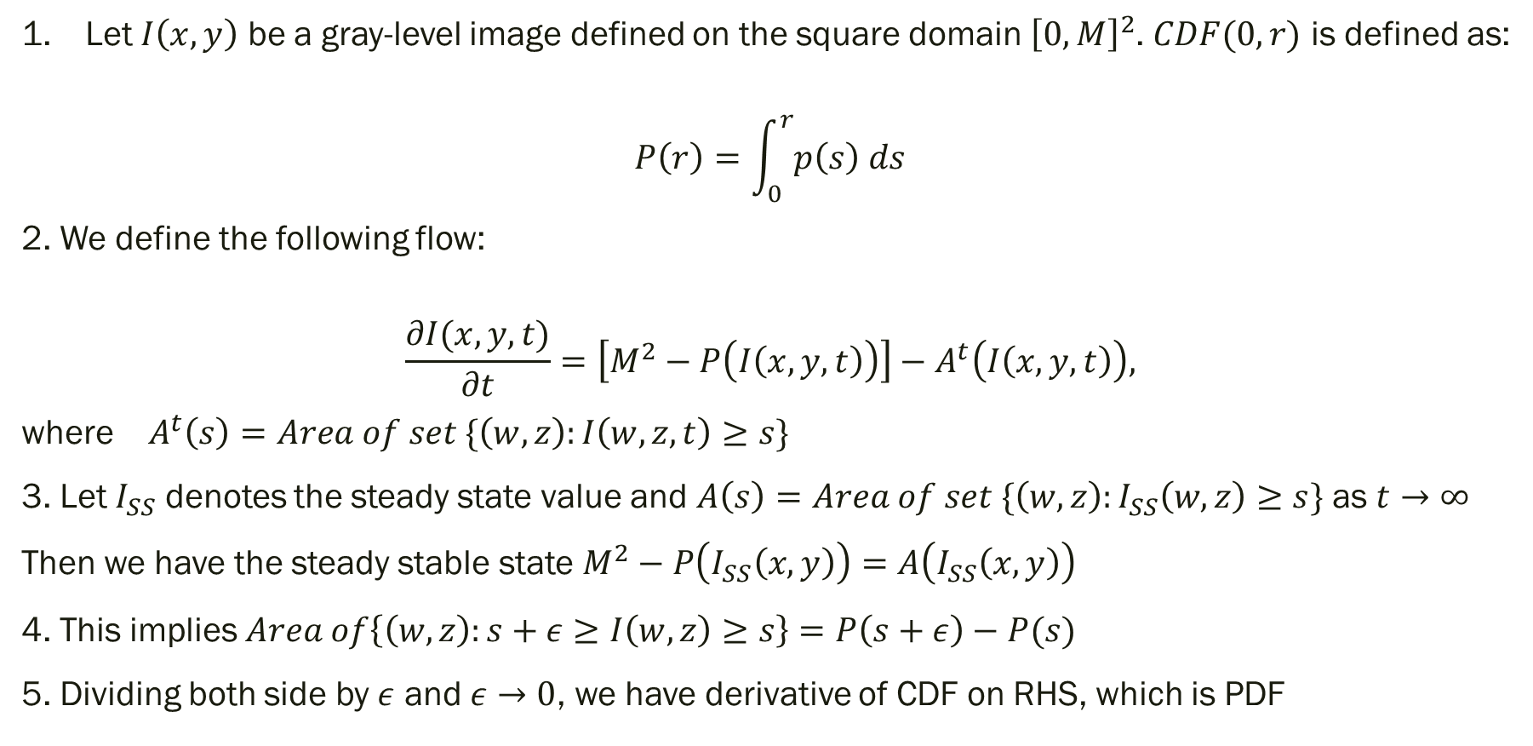
The Solution
Let $I\left(x,y\right)$ be a gray-level image defined on the square domain ${\left[0, M\right]}^{2}$. $CDF(0,r)$ is defined as:
$$P\left(r\right)=\int_{0}^{r}{p\left(s\right) ds}$$
2. We define the following flow:
$$\frac{∂I(x,y,t)}{∂t}=\left[M^{2}−P\left(I\left(x,y,t\right)\right)\right]−A^{t}\left(I\left(x,y,t\right)\right),$$
where $A^{t}\left(s\right)=Area of set \{\left(w,z\right):I\left(w,z,t\right)≥s\}$
3. Let $I_{SS}$ denotes the steady state value and $A\left(s\right)=Area of set \{\left(w,z\right):I_{SS}\left(w,z\right)≥s\}$ as $t→∞$
Then we have the steady stable state $M^{2}−P\left(I_{SS}\left(x,y\right)\right)=A\left(I_{SS}\left(x,y\right)\right)$
4. This implies $Area of\left\{\left(w,z\right):s+ε≥I\left(w,z\right)≥s\right\}=P\left(s+ε\right)−P(s)$
5. Dividing both side by $ε$ and $ε→0$, we have derivative of CDF on RHS, which is PDF

Slide 7

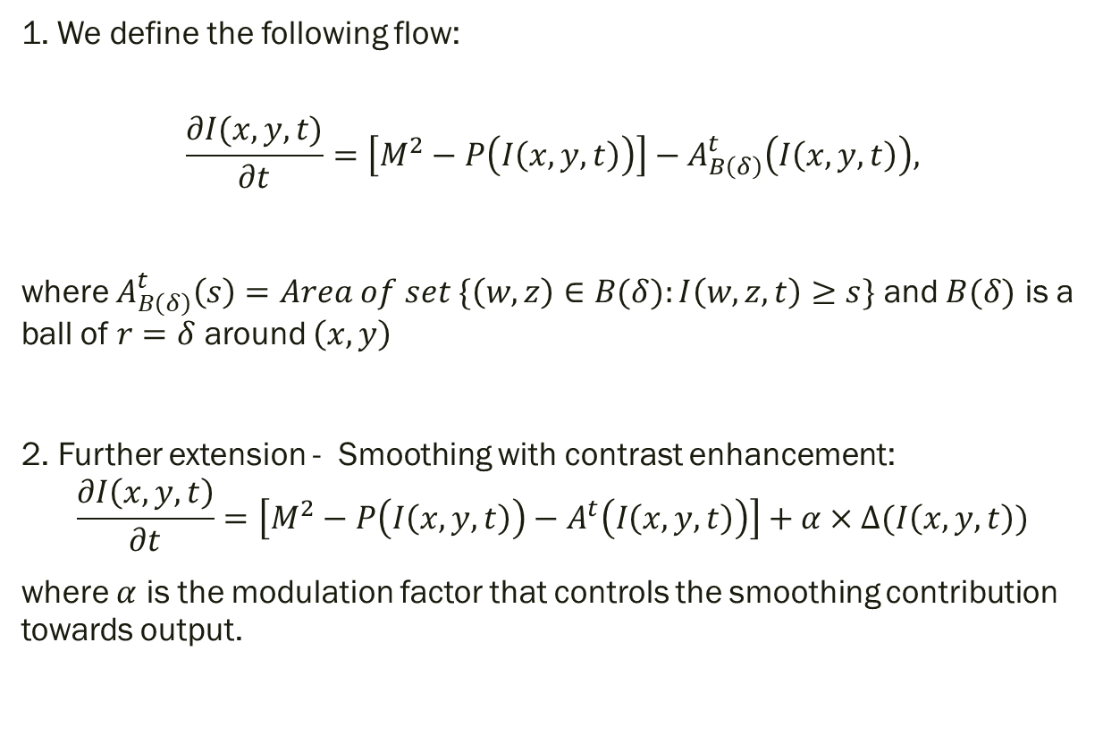
Local Contrast Enhancement
1. We define the following flow:
$$\frac{∂I(x,y,t)}{∂t}=\left[M^{2}−P\left(I\left(x,y,t\right)\right)\right]−A_{B\left(δ\right)}^{t}\left(I\left(x,y,t\right)\right),$$
where $A_{B\left(δ\right)}^{t}\left(s\right)=Area of set \{\left(w,z\right)∈B(δ):I\left(w,z,t\right)≥s\}$ and $B(δ)$ is a ball of $r=δ$ around $\left(x,y\right)$
2. Further extension - Smoothing with contrast enhancement:
$$\frac{∂I\left(x,y,t\right)}{∂t}=\left[M^{2}−P\left(I\left(x,y,t\right)\right)−A^{t}\left(I\left(x,y,t\right)\right)\right]+α×Δ(I\left(x,y,t\right))$$
where $α$ is the modulation factor that controls the smoothing contribution towards output.

Slide 8
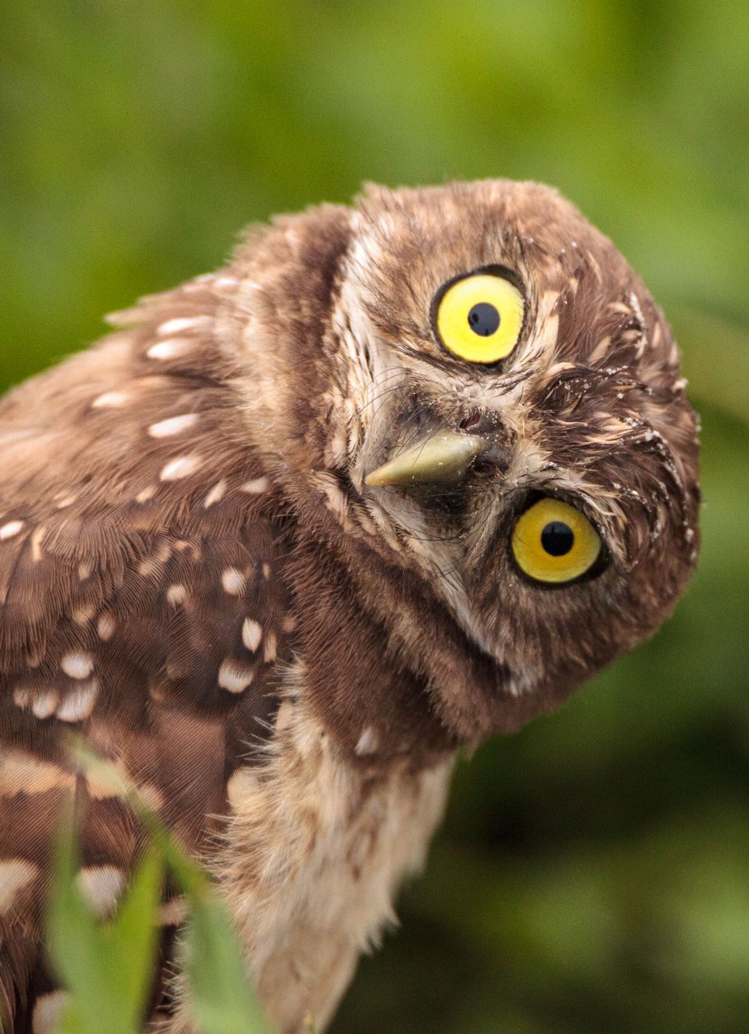
Results

Slide 9
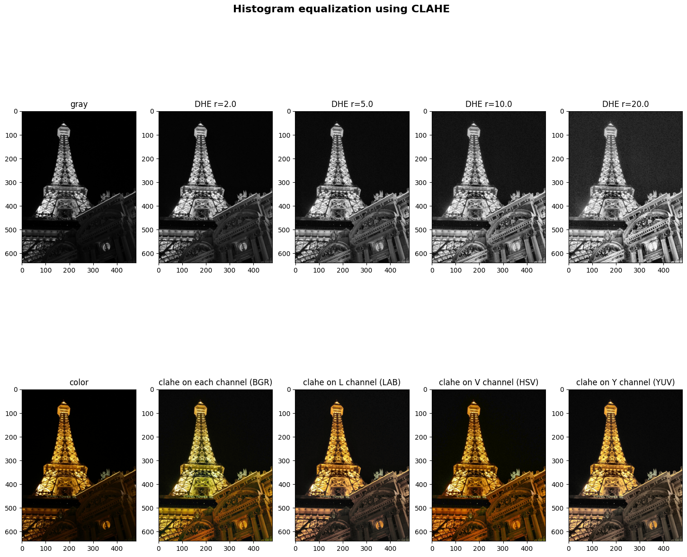
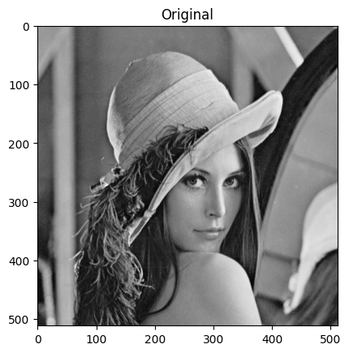
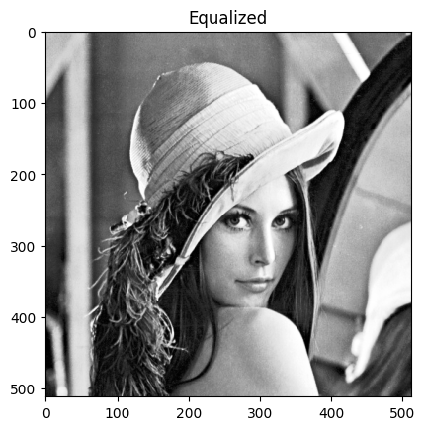
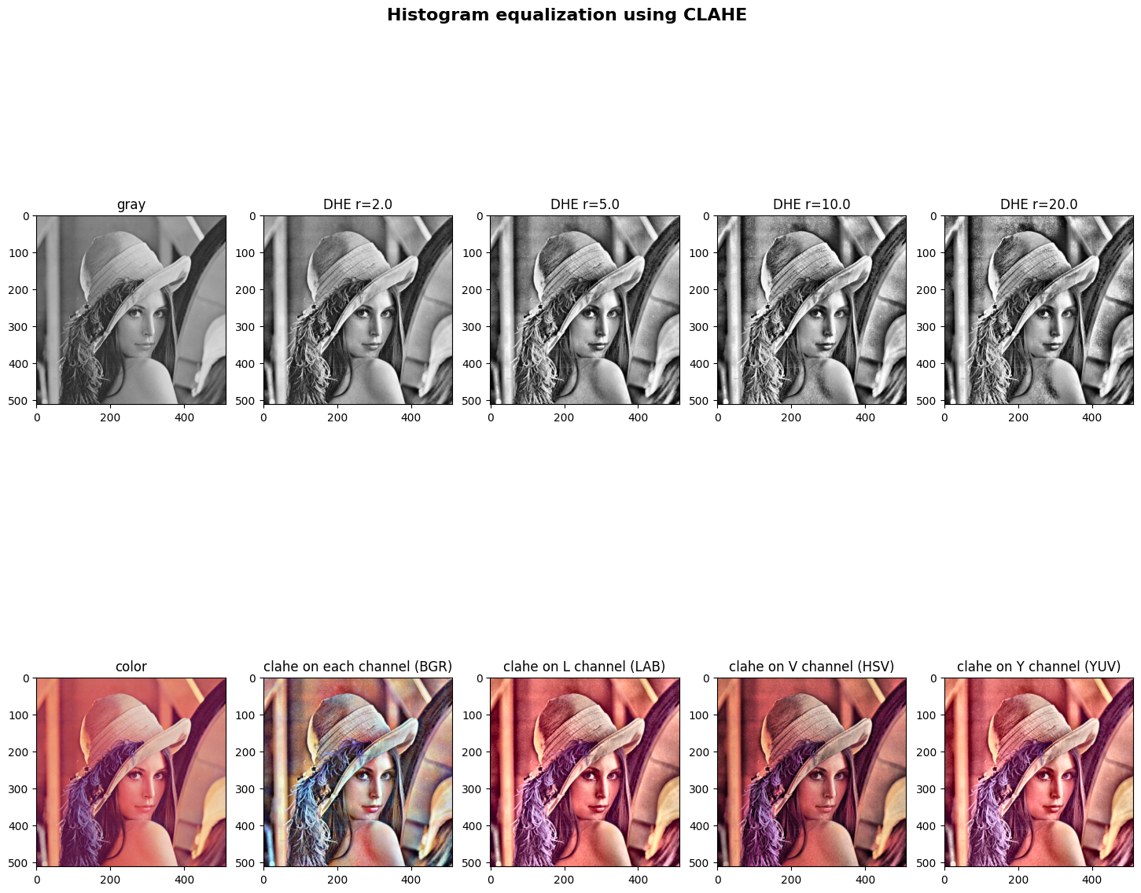
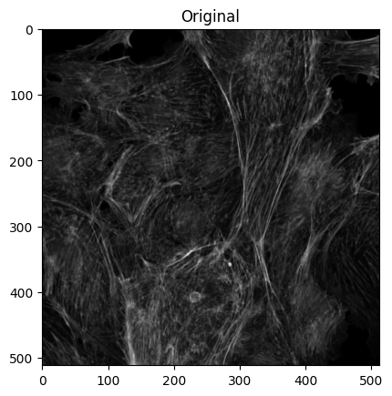
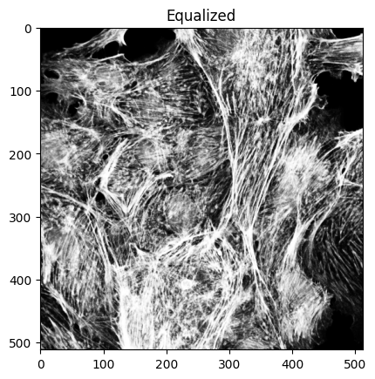
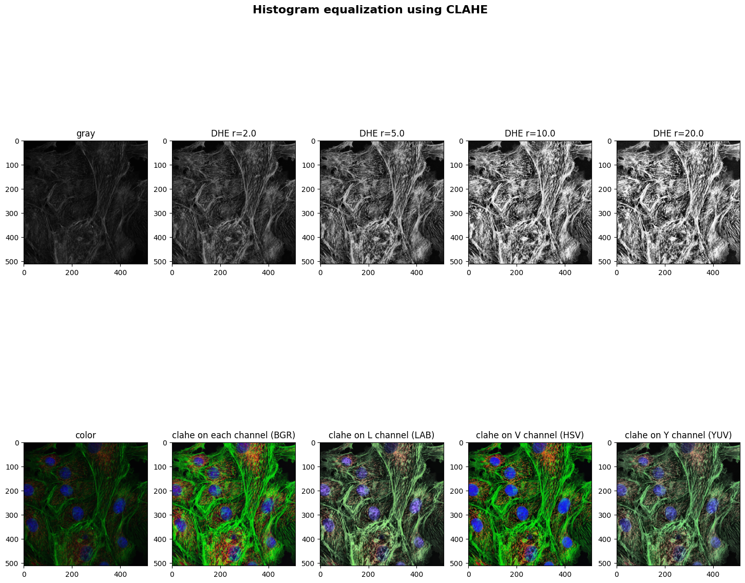

Slide 10
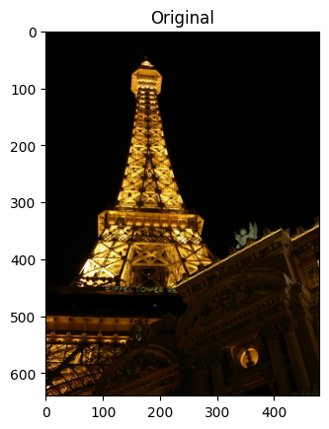
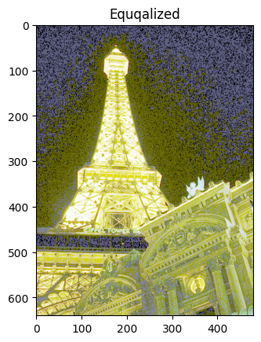

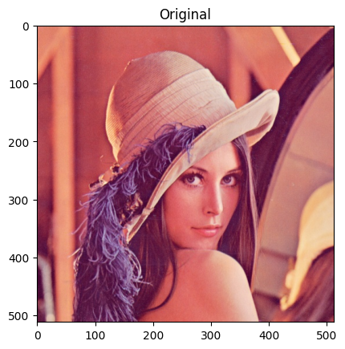
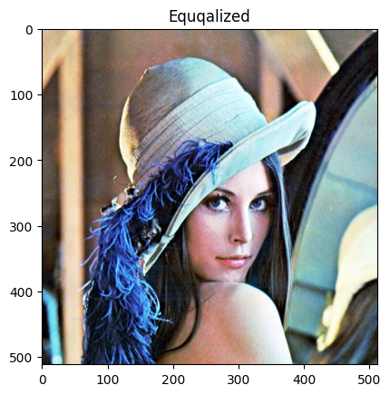

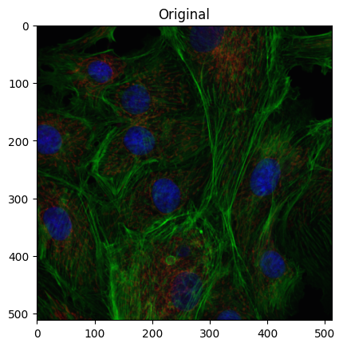
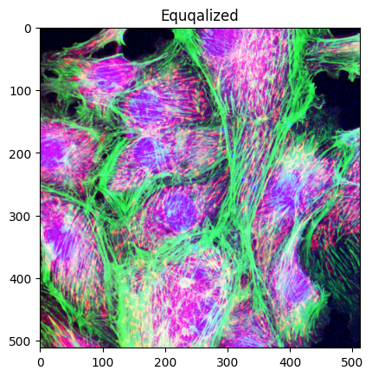


Slide 11
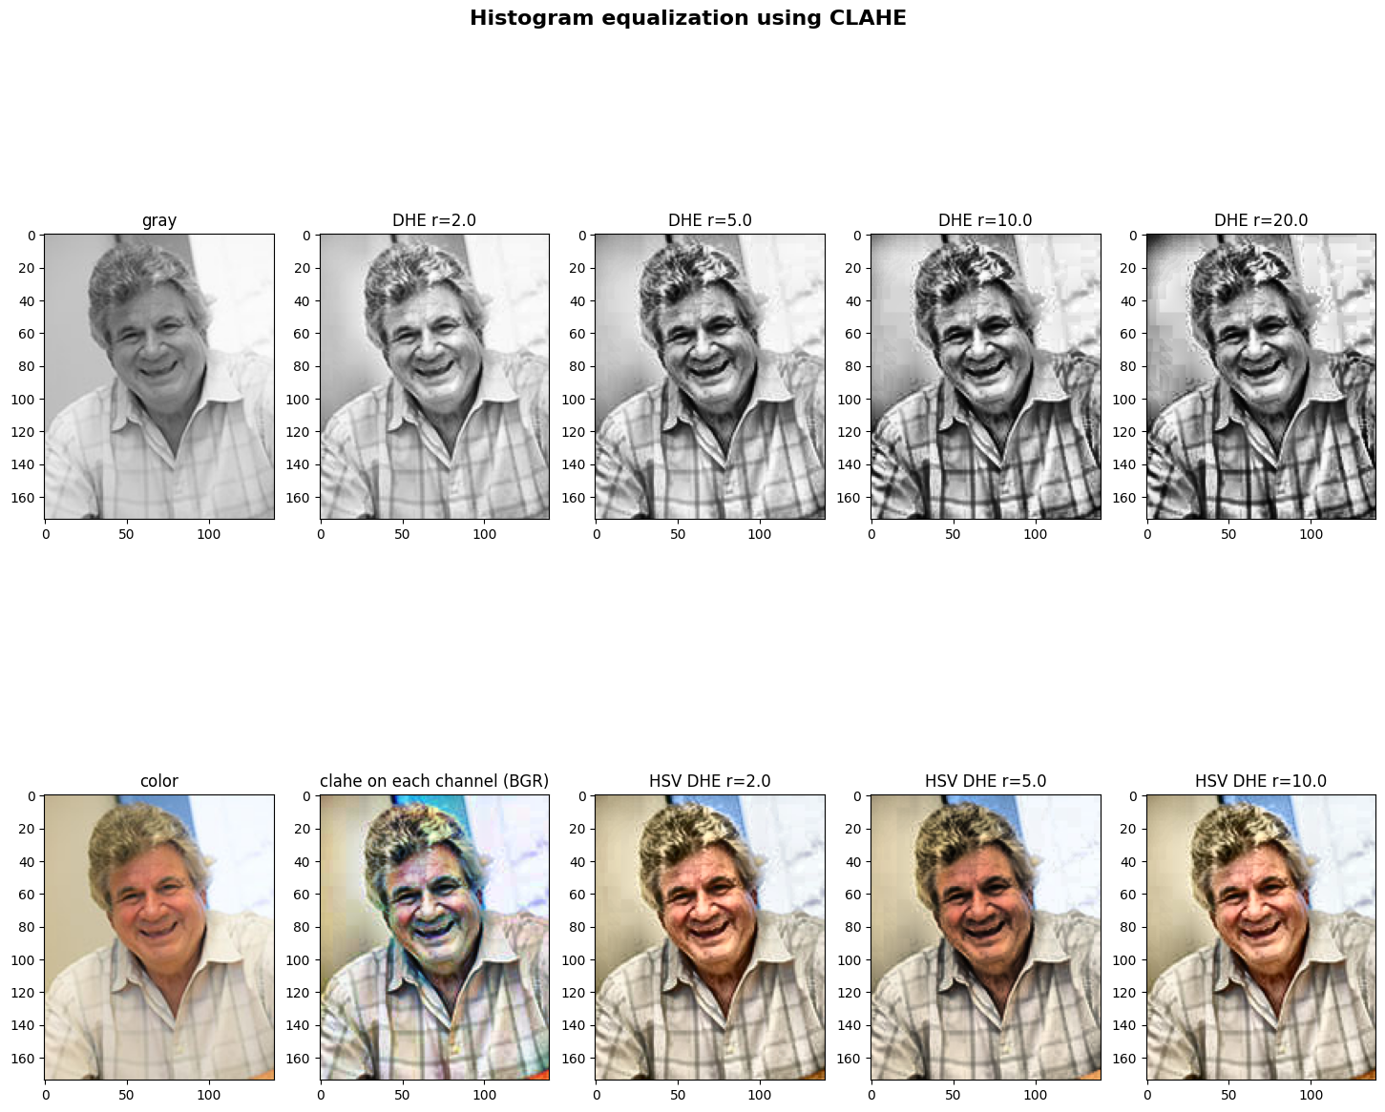

Slide 12
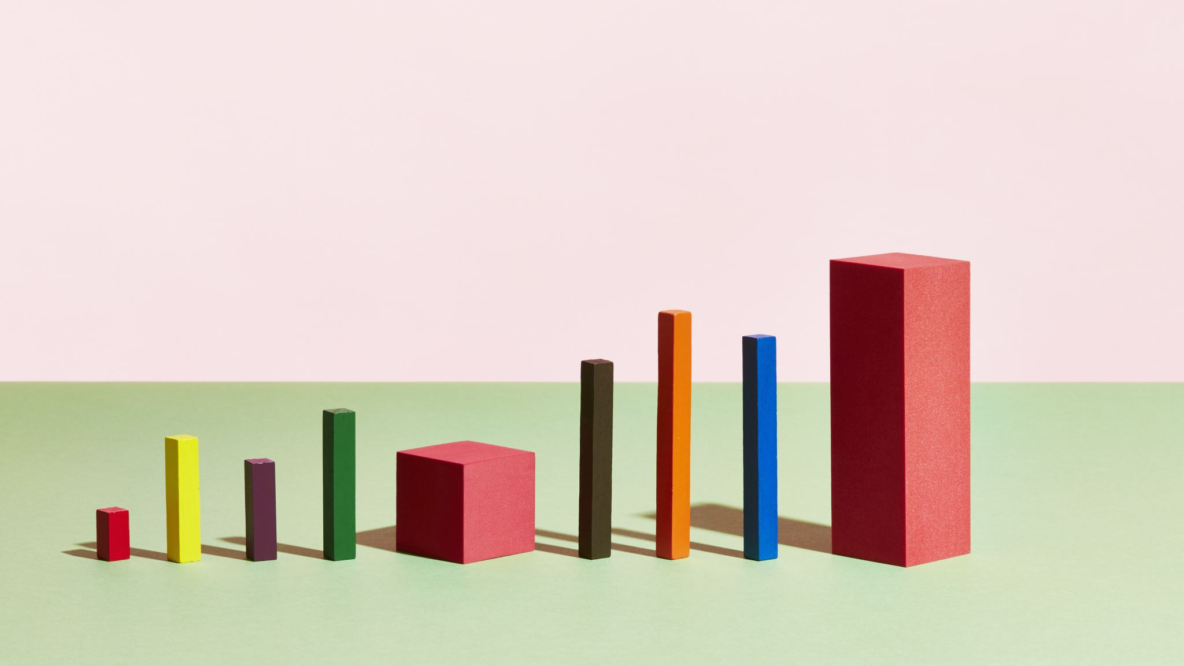
COLOR HISTOGRAM EQUALIZATION

Slide 13
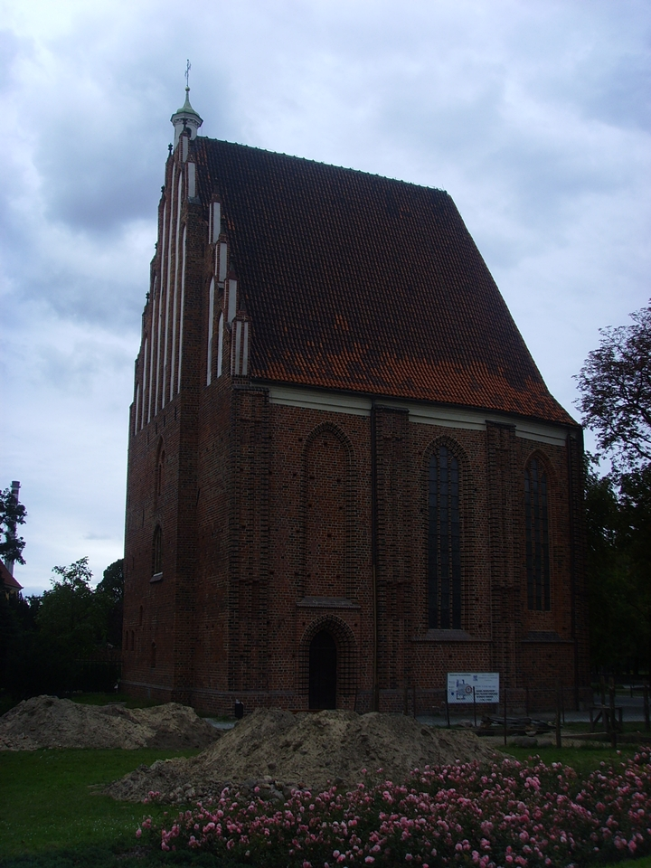
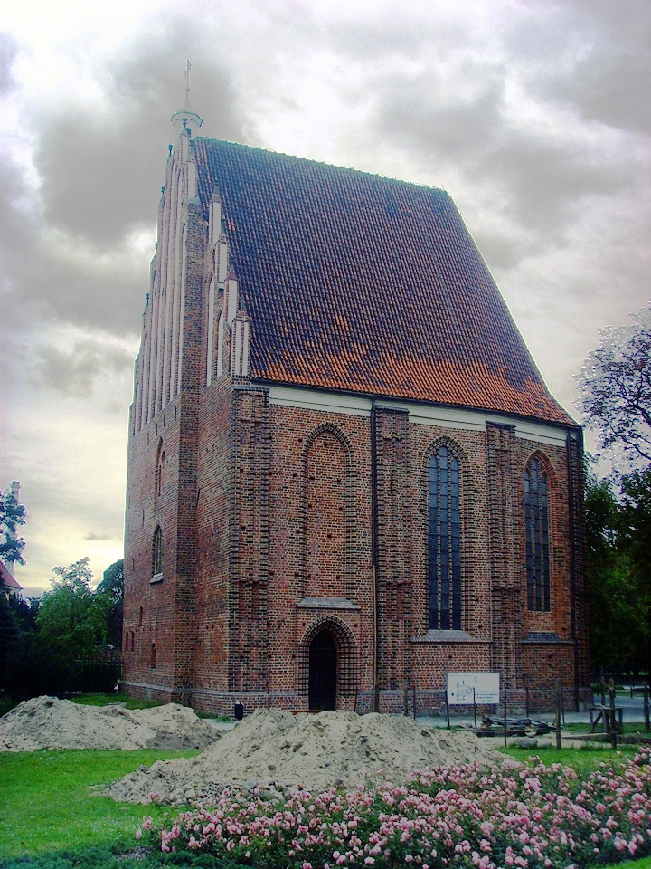
Traditional Method
We split three channels R, G, and B separately
Equalize the histograms of the three channels separately
Merge the three channels
Input Image
Histogram equalized Image
Notes:
Thus, we get histogram equalized image or image with improved contrast.
In order to improve the contrast more The stretching is done by mapping the minimum and maximum pixel values of the histogram to the minimum and maximum pixel values of the output image.

Slide 14
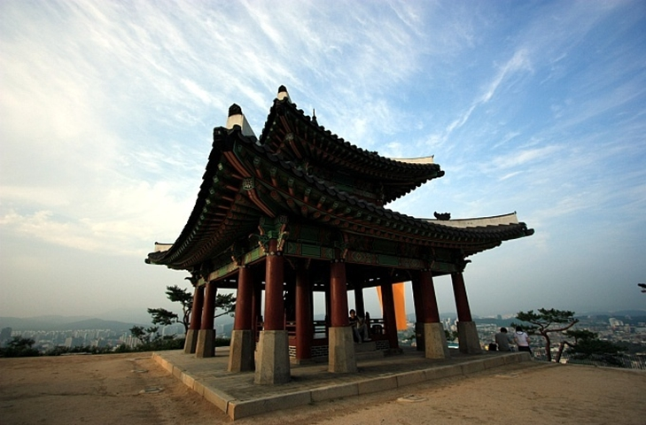
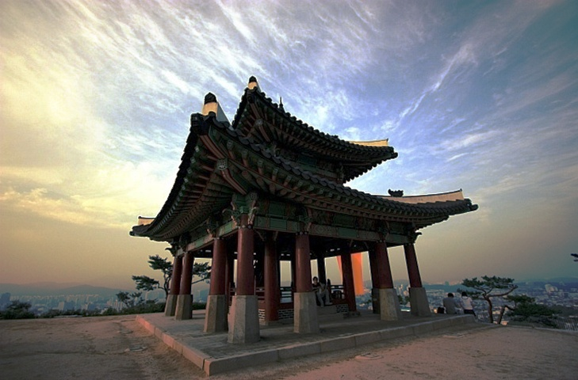
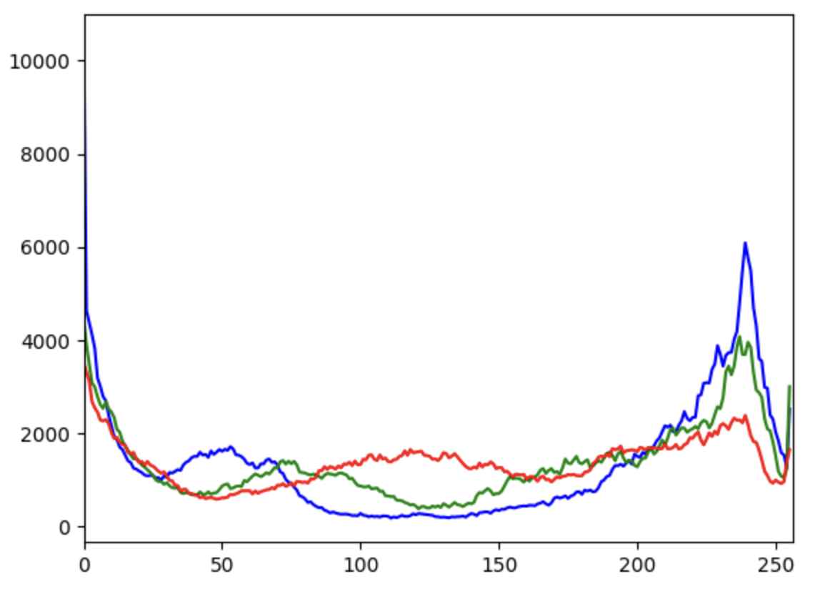
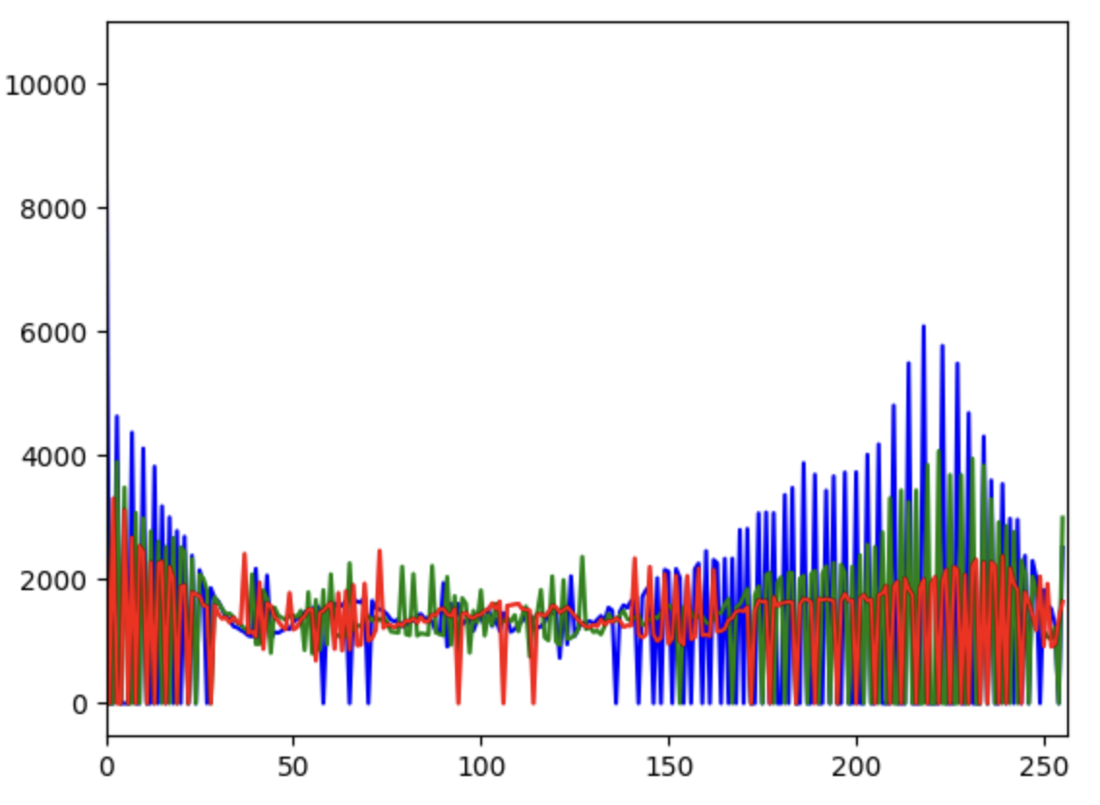
Input Image
Histogram equalized Image
Initial Histogram
Modified/ Equalized Histogram

Slide 15
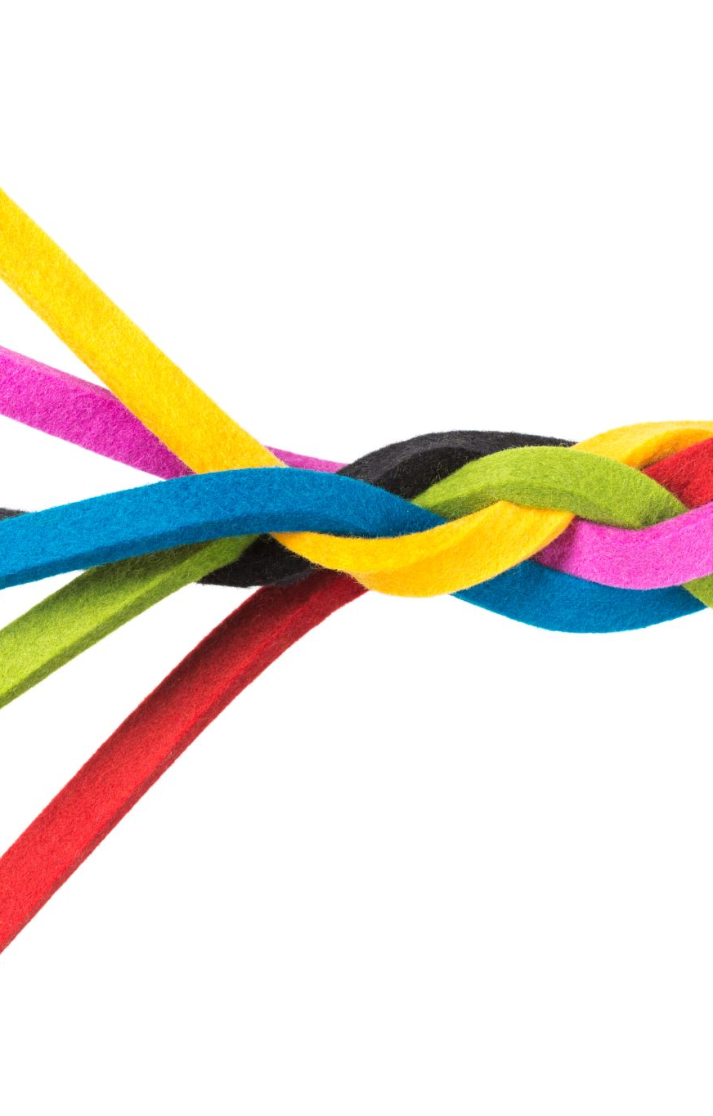
DRAWBACKS OF THIS METHOD
Performing histogram equalization on each of the three-color channels (red, green, and blue) separately can lead to an image with unnatural colors and contrast.
This can also cause a loss of color information.
Hence, there is a need for approach that can preserve the color balance of the image while still improving overall contrast.
Notes:
When applied separately to each channel, the equalization process can affect the colors differently, causing color shifts and imbalances. For example, if a particular color is dominant in one channel, equalizing that channel can lead to a shift in overall color balance.

Slide 16

SOLUTION using mesh deformation

Slide 17
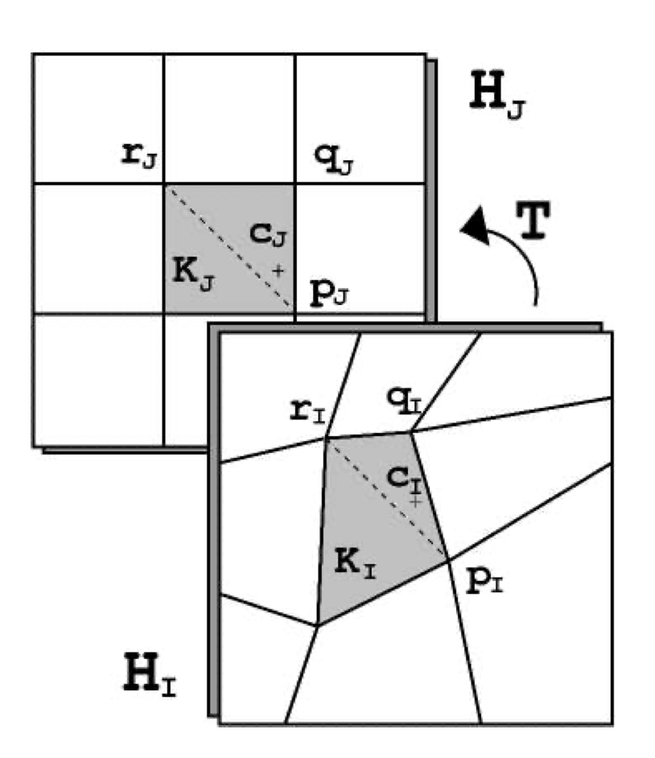
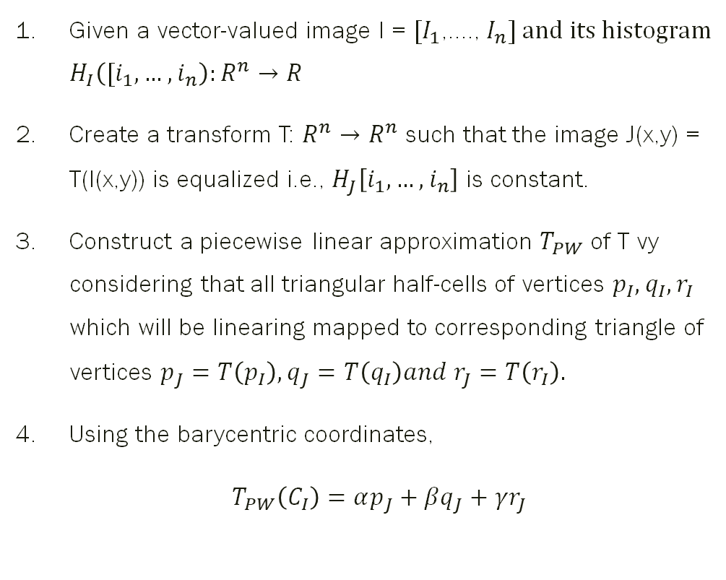
IDEA
Given a vector-valued image $\text{I}\text{ = }[I_{1}$,...., $I_{n}] and its histogram$ $H_{I}\left({[i_{1},…,i}_{n}\right):R^{n}→R$
Create a transform T: $R^{n}→R^{n}$ such that the image J(x,y) = T(I(x,y)) is equalized i.e., $H_{J}\left[i_{1},…,i_{n}\right]$ is constant.
Construct a piecewise linear approximation $T_{PW}$ of T vy considering that all triangular half-cells of vertices $p_{I}, q_{I},r_{I}$ which will be linearing mapped to corresponding triangle of vertices $p_{J}=T\left(p_{I}\right), q_{J}=T\left(q_{I}\right)and r_{J}=T\left(r_{I}\right).$
Using the barycentric coordinates,
$T_{PW}\left(C_{I}\right)=αp_{J}+βq_{J}+γr_{J}$
The transformation T can be represented by a mesh

Slide 18
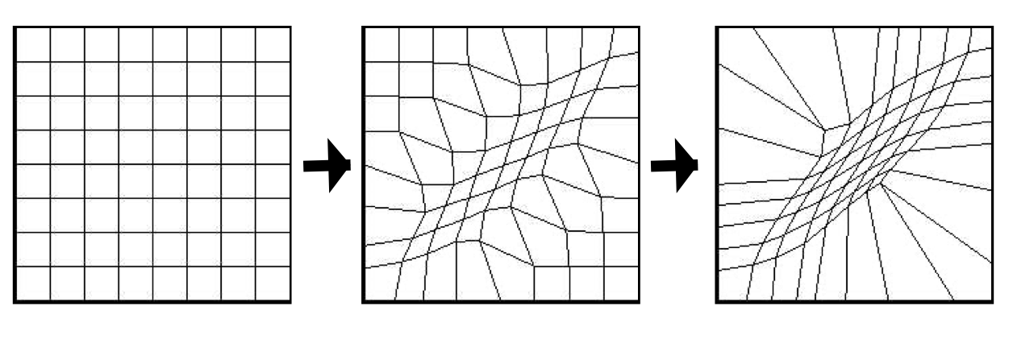
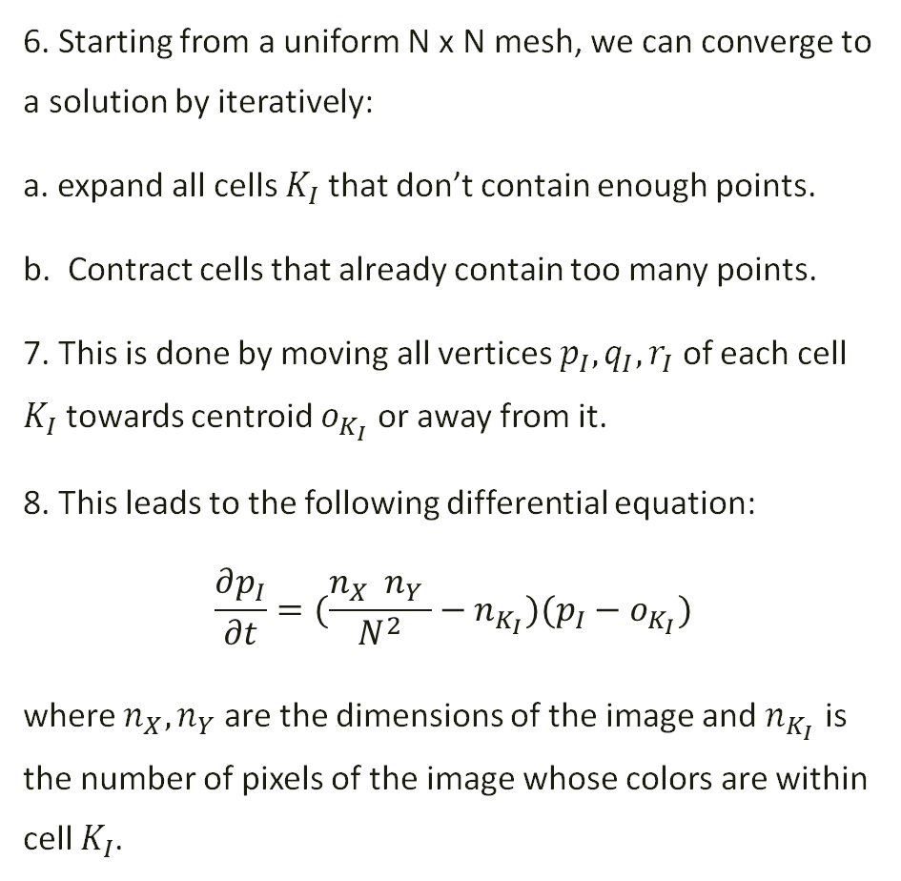
IDEA (cont.)
6. Starting from a uniform N x N mesh, we can converge to a solution by iteratively:
a. expand all cells $K_{I}$ that don’t contain enough points.
b. Contract cells that already contain too many points.
7. This is done by moving all vertices $p_{I},q_{I},r_{I}$ of each cell $K_{I}$ towards centroid $o_{K_{I}}$ or away from it.
8. This leads to the following differential equation:
$$\frac{∂p_{I}}{∂t}=(\frac{n_{X} n_{Y} }{N^{2}}−n_{K_{I}})(p_{I}−o_{K_{I}})$$
where $n_{X}, n_{Y}$ are the dimensions of the image and $n_{K_{I}}$ is the number of pixels of the image whose colors are within cell $K_{I}$.
Mesh deforming to fit histogram on some figure
Notes:
At steady state, nki = nxny/n^2 is constant, all cells contain the same number of points

Slide 19

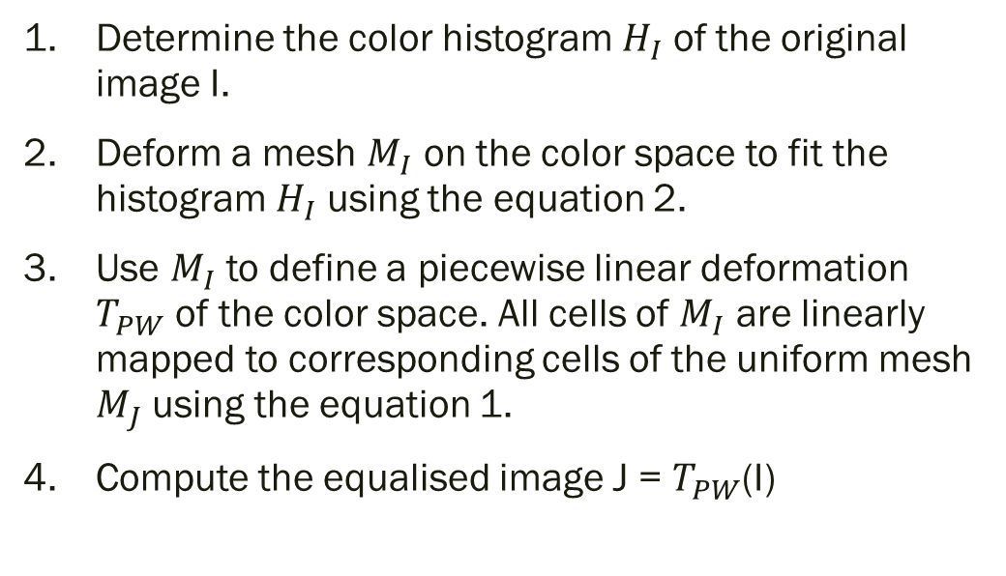
ALGORITHM
Determine the color histogram $H_{I}$ of the original image I.
Deform a mesh $M_{I}$ on the color space to fit the histogram $H_{I}$ using the equation 2.
Use $M_{I}$ to define a piecewise linear deformation $T_{PW}$ of the color space. All cells of $M_{I}$ are linearly mapped to corresponding cells of the uniform mesh $M_{J}$ using the equation 1.
Compute the equalised image J = $T_{PW}$(I)

Slide 20
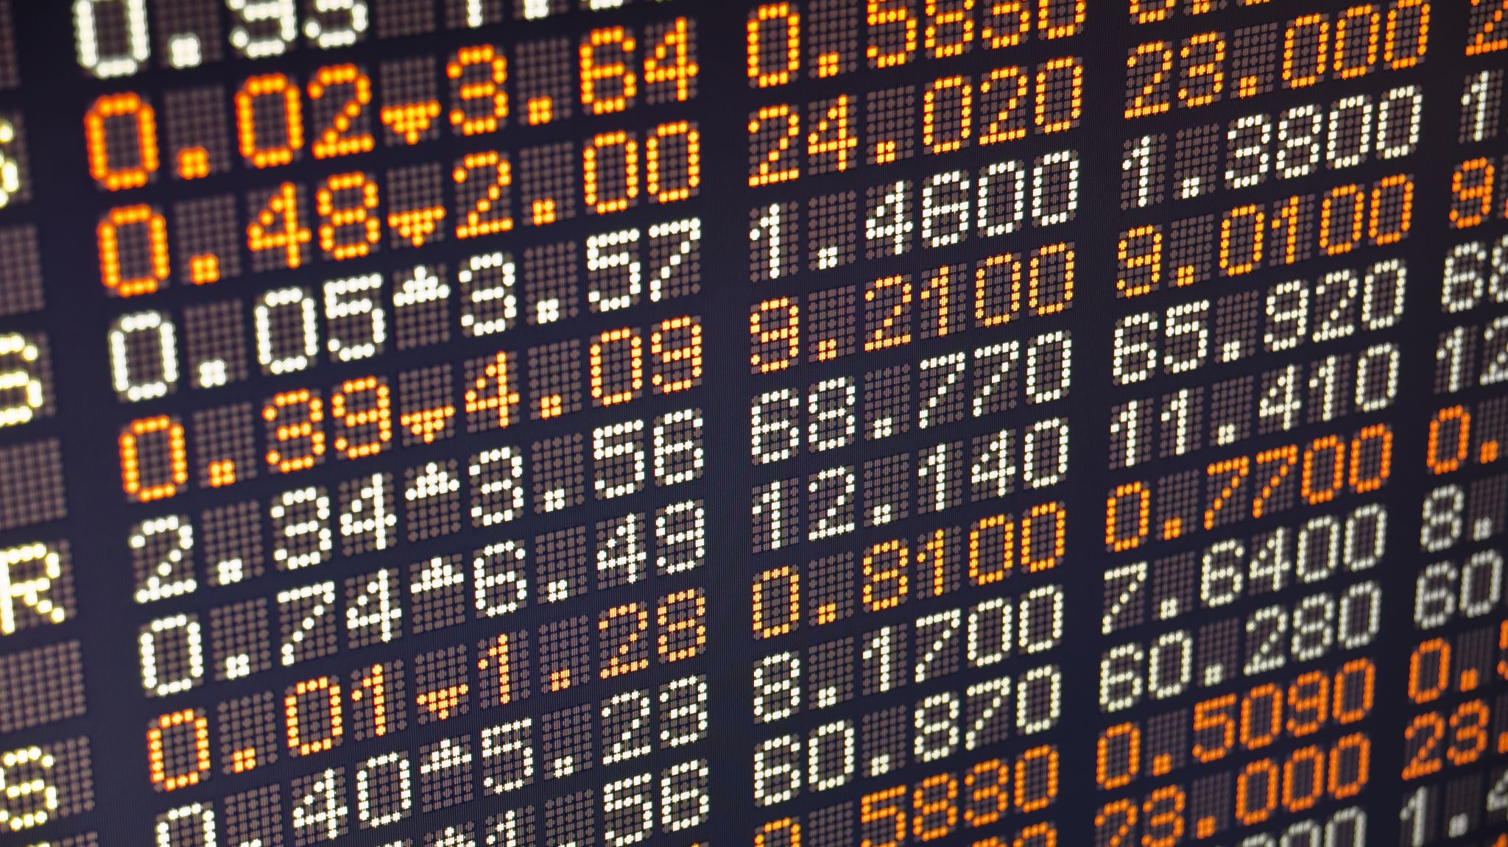
Results

Slide 21
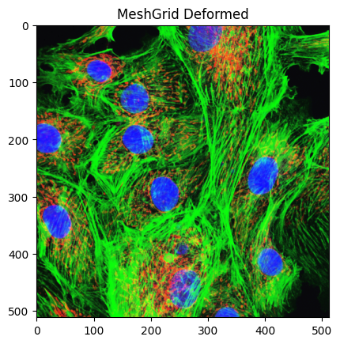
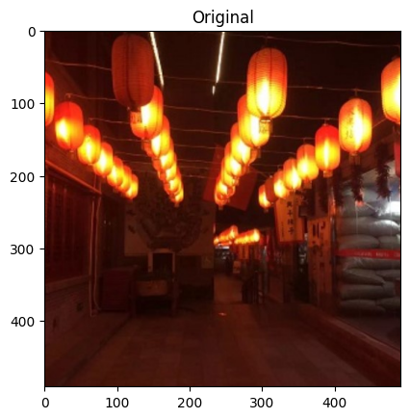
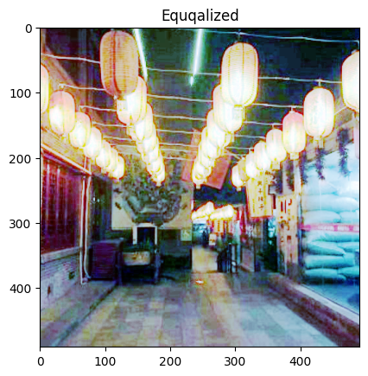
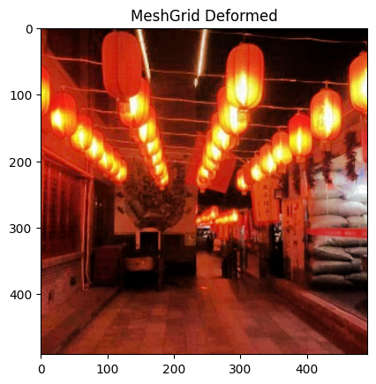
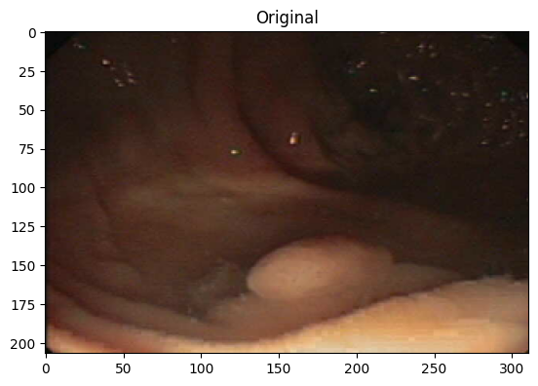
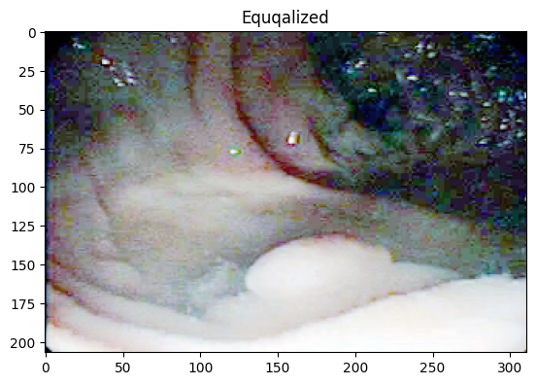
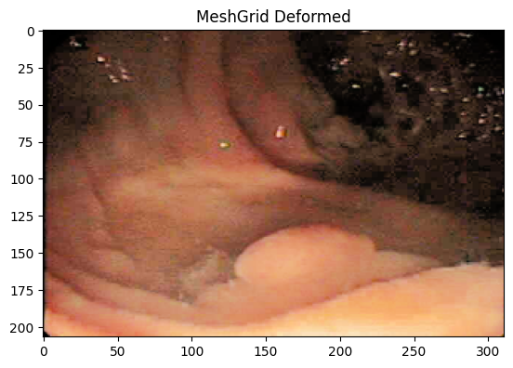

Slide 22
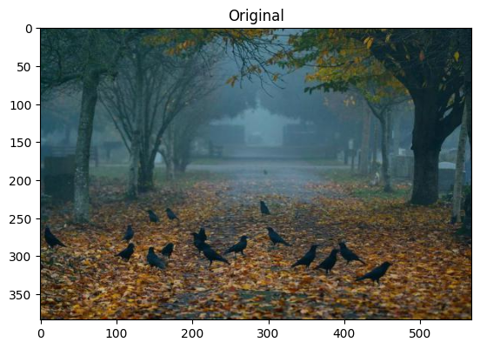
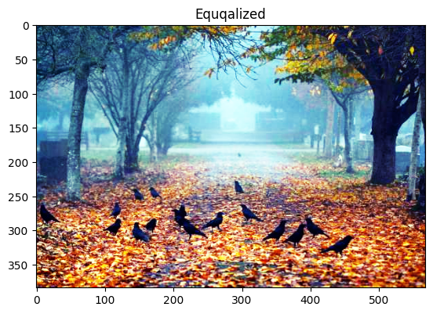
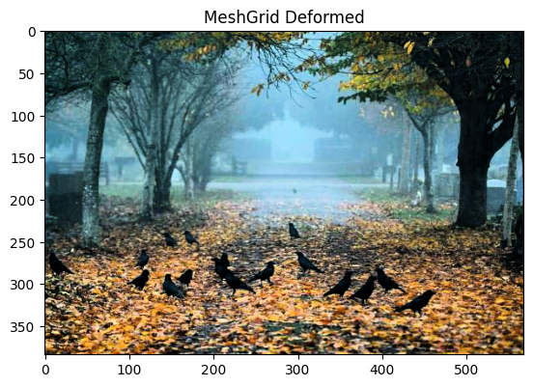
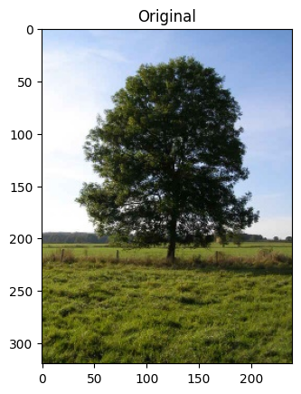
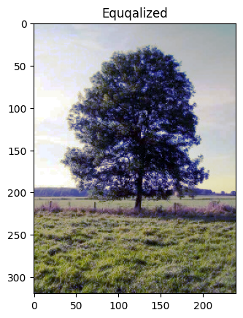





Slide 23

References
Pichon E, Niethammer M, Sapiro G. Color histogram equalization through mesh deformation. InProceedings 2003 International Conference on Image Processing (Cat. No. 03CH37429) 2003 Sep 14 (Vol. 2, pp. II-117). IEEE.
Sapiro G, Caselles V. Contrast enhancement via image evolution flows. Graphical Models and Image Processing. 1997 Nov 1;59(6):407-16.
Reza AM. Realization of the contrast limited adaptive histogram equalization (CLAHE) for real-time image enhancement. Journal of VLSI signal processing systems for signal, image and video technology. 2004 Aug;38:35-44.

Slide 24

Questions?

